Slide 1


NYU Cyber Fellows
CS GY 6573
Penetration Testing
Lab 1 - Getting Started with VirtualBox and Kali
©2021 NYU Tandon School of Engineering

Slide 2
Goal
The goal of this lab is to get Kali Linux up and running
We can do this using virtualization, using a live USB or DVD, or setting up Kali in the cloud (Amazon EC2)
For this class, it would be best to virtualize
We will be deploying other VMs (*.ova files) later this semester at the same time as Kali
By virtualizing, we’ll have the easiest experience of managing several hosts that need to be online and networked
Once Kali is set up, we will also deploy Metasploitable
Metasploitable will be a common target we’ll use through the semester

Slide 3
Setup Virtual Environment

Slide 4
Virtualizing
We will be running VMs in this class for labs, assignments, and the final project
I recommend VirtualBox - it's free and runs well on most platforms
You can use VMware or any other hypervisor your want, but you may have issues getting the OVAs to deploy and networked correctly
Your system should meet the minimum requirements:
https://www.virtualbox.org/wiki/End-user_documentation
Any reasonably powerful x86 hardware
8GB of RAM (16GB recommended)
About 30GB free space

Slide 5
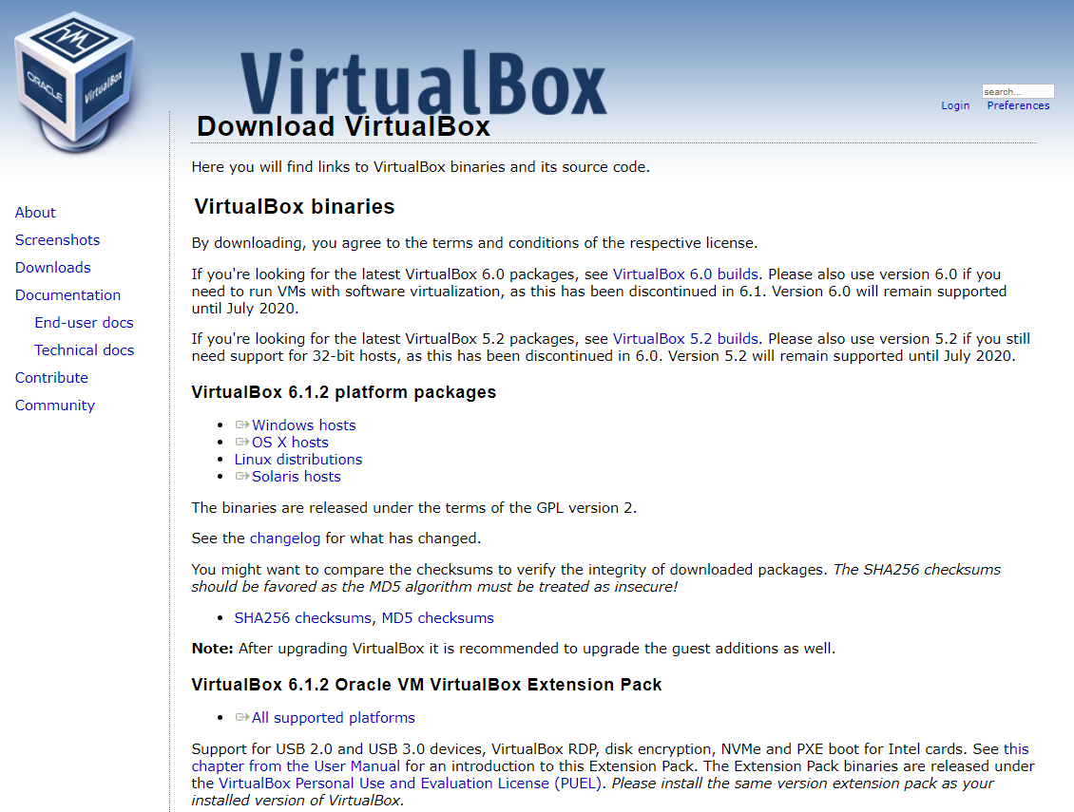
VirtualBox
https://www.virtualbox.org/wiki/Downloads
1- Download & Install
2 - Install Extension Pack

Slide 6
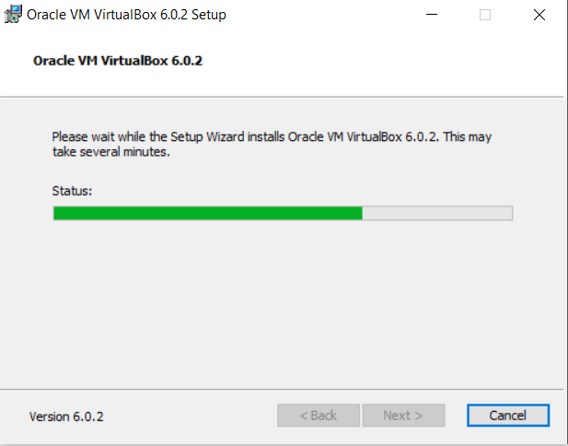
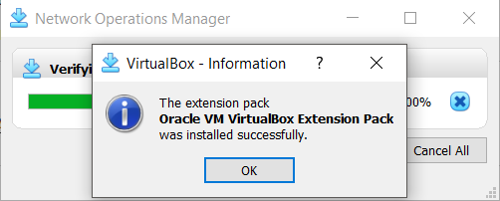
Virtualbox Install
Windows and Mac
Use default options, installation is straight forward and should have no issues
Linux
Follow instructions based on your distribution
https://www.virtualbox.org/wiki/Linux_Downloads
Don't forget to install the Extension Pack!

Slide 7
Vmware Player
https://www.vmware.com/products/workstation-player/workstation-player-evaluation.html
Only Windows and Linux
No free version for OSX
VMWare Fusion is the alternative if you have a license

Slide 8
Networking

Slide 9
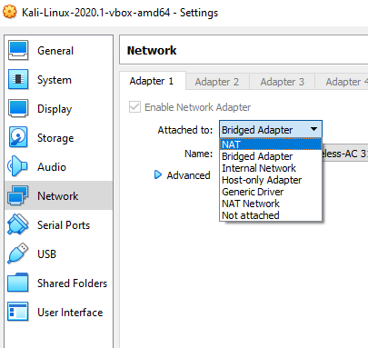
Networking Types
There are several types of network options for deployed VMs
With all options, VMs on the same network should be able to communicate to each other
NAT
Host machine becomes an internet gateway
VM has internet access
Host machine cannot communicate to VM without port forwarding
Good for “normal” use
Bridged
Host machine forwards all traffic to LAN gateway
VM and Host are on the same LAN
Different IP addresses but share a MAC address
VMs can communicate to one another
Preferred if doing any kind of scanning or exploiting externally
Internal/Host-only
VMs cannot access the internet
Internal means the host cannot communicate to the VM
Both Internal and Host-only, VMs can communicate to each other
Best if running vulnerable target VMs, no internet access required

Slide 10
Lab Network
How you set up networking is up to you but remember that we will be using hacking tools and deploying dangerous/vulnerable VMs
The slides will explain how to use NAT
It doesn't matter which option you choose, as long as the VMs can communicate on the same subnet AND it is secure
If you are in your own private network behind a NAT gateway (like a router), it may be safe to just set it up on your own LAN in bridged mode
Remember that anything you deploy will be vulnerable to anything that is hostile on your network

Slide 11
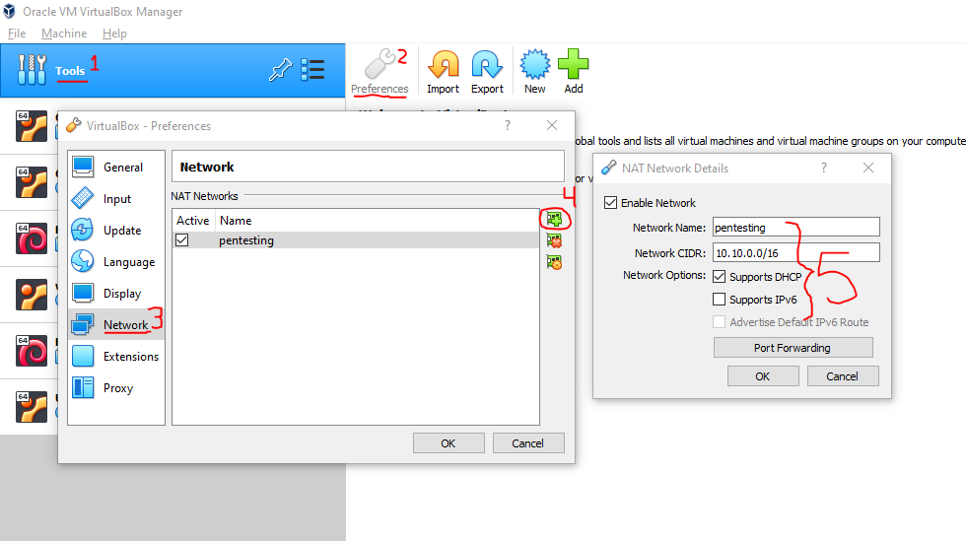
Create a NAT network
Windows
Create a new NAT network
Call it anything
Set its network to 10.10.0.0/24
No need to enable IPv6 or configure port forwarding for now

Slide 12
Create a NAT Network
Mac OSX
You will not have a Tools option
Instead go to
VirtualBox > Preferences > Network
Follow the same instructions

Slide 13
Deploy Kali, virtual

Slide 14
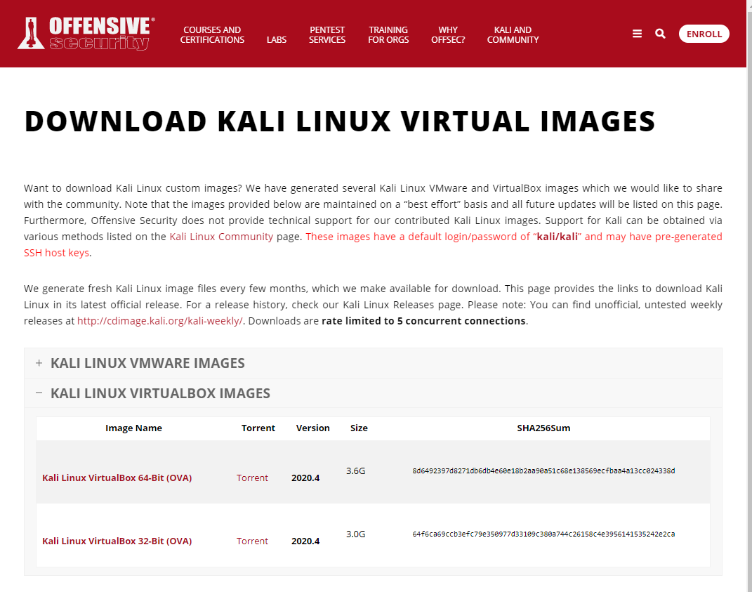
You can download premade versions of Kali for VirtualBox or VMWare
Use the 64-bit version
https://www.offensive-security.com/kali-linux-vm-vmware-virtualbox-image-download/
Latest 64-bit version

Slide 15
Import the Kali Image
Open VirtualBox
File -> Import Appliance -> Select the *.ova file
It should be intuitive
If you need help, ask questions on Slack
A good tutorial:
https://www.maketecheasier.com/import-export-ova-files-in-virtualbox/

Slide 16
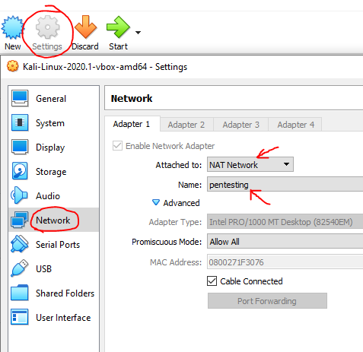
Change Network Settings
We need to go to
Machine -> Settings
Network tab
Attach to NAT network
Select the NAT you created
We want to reach the internet and also communicate with other VMs
This is safer than Bridged
Do not deploy dangerous or vulnerable VMs to a LAN unless you trust it and own it

Slide 17
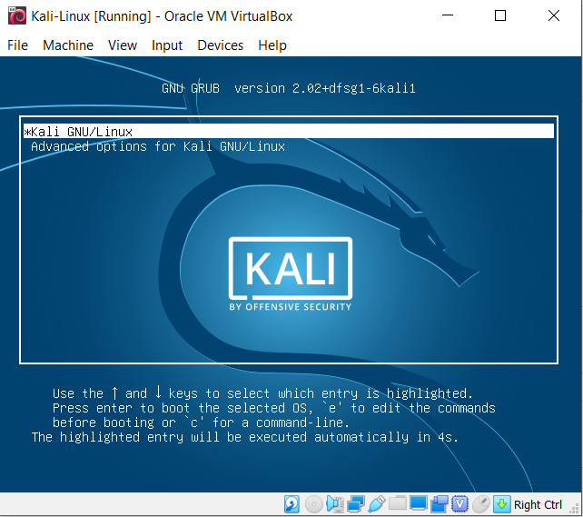
Start Kali
Default option, press enter
User
kali
Password
kali
Troubleshooting:
Make sure you install the extension pack
Ask on Slack!

Slide 18
Kali Tools and Metapackage
Kali organizes many of its tools and packages into Metapackages
Metapackages are a way to link or group many similar tools
This keeps instances of Kali lightweight if only a specific toolset is needed
Examples are kali-linux-wireless or kali-linux-headless
Kali VM includes some tools and packages, found in these metapackages
kali-linux-core
Kali-linux-default
If installing manually or want to add additional metapackages, please review the tool and metapackage list page for the latest details:
https://tools.kali.org/kali-metapackages
More info:
https://www.kali.org/news/major-metapackage-makeover

Slide 19

Metasploitable

Slide 20
Metasploitable
Metasploitable 2 is an Ubuntu distribution released by Rapid7
Its purpose is to be vulnerable and let us practice!
Direct Download:
http://downloads.metasploit.com/data/metasploitable/metasploitable-linux-2.0.0.zip
Or sourceforge mirrors:
https://sourceforge.net/projects/metasploitable/
Metasploitable has been around since 2012 and is well documented
Troubleshooting should be easy. If any issues completing anything in this lab, research first, then ask questions

Slide 21

Network Setup - VirtualBox
Future labs will require that we use VirtualBox since there is no version of Metasploitable ready and available AWS
AWS only allows penetration testing of medium systems (you need to pay $$$) and also get explicit authorization
It should NEVER be allowed to face the open internet
This system's purpose is to get scanned and hacked
Exposing to the internet will probably turn it into a bitcoin mining host within a day
Security - We should use NAT, Host-only, or Internal networking
This will allow our VMs and host to communicate internally
Alternatively, we can whitelist IP addresses using iptables

Slide 22
Deploying Metaploitable

Slide 23



Setup
You are to deploy the image to your local machine
You will need to configure VirtualBox, VMware, etc.
Your host-only interface needs to be setup so you are on the same network
Do not expose this VM to the internet or an untrusted network - it's vulnerable
The next few slides we will:
Deploy VM
Set up host-only networking
Configure Kali and the VM
Metasploitable2
Kali
10.10.0.*
10.10.0.20
10.10.0.0/24

Slide 24
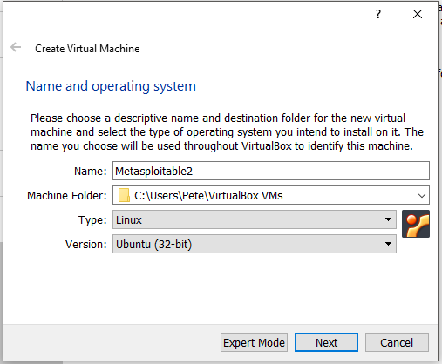
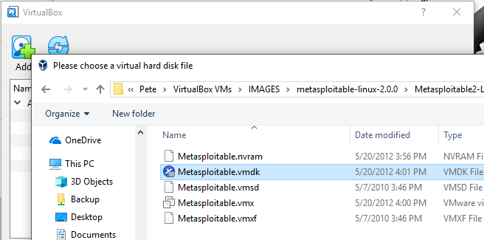
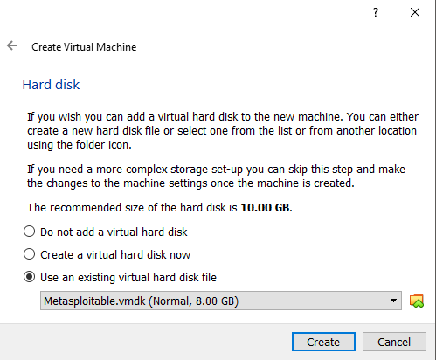
Metasploitable
Download and Unzip metasploitable-linux-2.0.0.zip
Instructions for deploying in Virtualbox:
Open VirtualBox
Machine->New... (Ctrl+N)
Name: Metasploitable
Type: Linux
Version: Ubuntu 32-bit
Default RAM
Use existing virtual hard disk -> Metasploitable.vmdk
You will need to manually add it
Start VM
Username and password are both 'msfconsole'
Stuck with keyboard-only input on a small screen
You can SSH into it on a GUI for a more friendly interface if required

Slide 25
Change Network Settings
Just like Kali - we need to go to
Machine -> Settings
Network tab
Attach to NAT network
Select the NAT you created
We want to reach the internet and also communicate with other VMs
This is safer than Bridged
Do not deploy dangerous or vulnerable VMs to a LAN unless you trust it and own it

Slide 26
Networking
Start the Metasploitable VM and Kali
Once they are both on, you will need to set IPs on the same subnet so they can communicate
You can use a different network address for your host-only network
All the examples in this lab will assuming you are using 10.10.0.0/24
Next: Setup your IP addresses

Slide 27
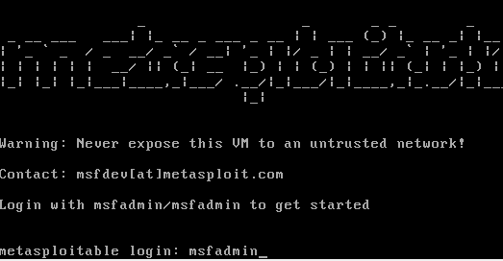

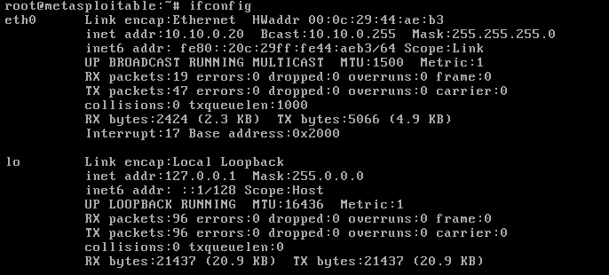
Metasploitable Setup
Login, escalate privs, and set IP
Login with 'msfadmin' as user and pass
Become root
$ sudo su -
Enter password again: msfadmin
Check name of network adapter
Probably 'eth0' but could vary
# ifconfig
Set your IP where [name] is your adapter, probably eth0!
# ifconfig [name] 10.10.0.20 netmask 255.255.255.0

Slide 28
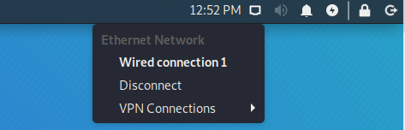
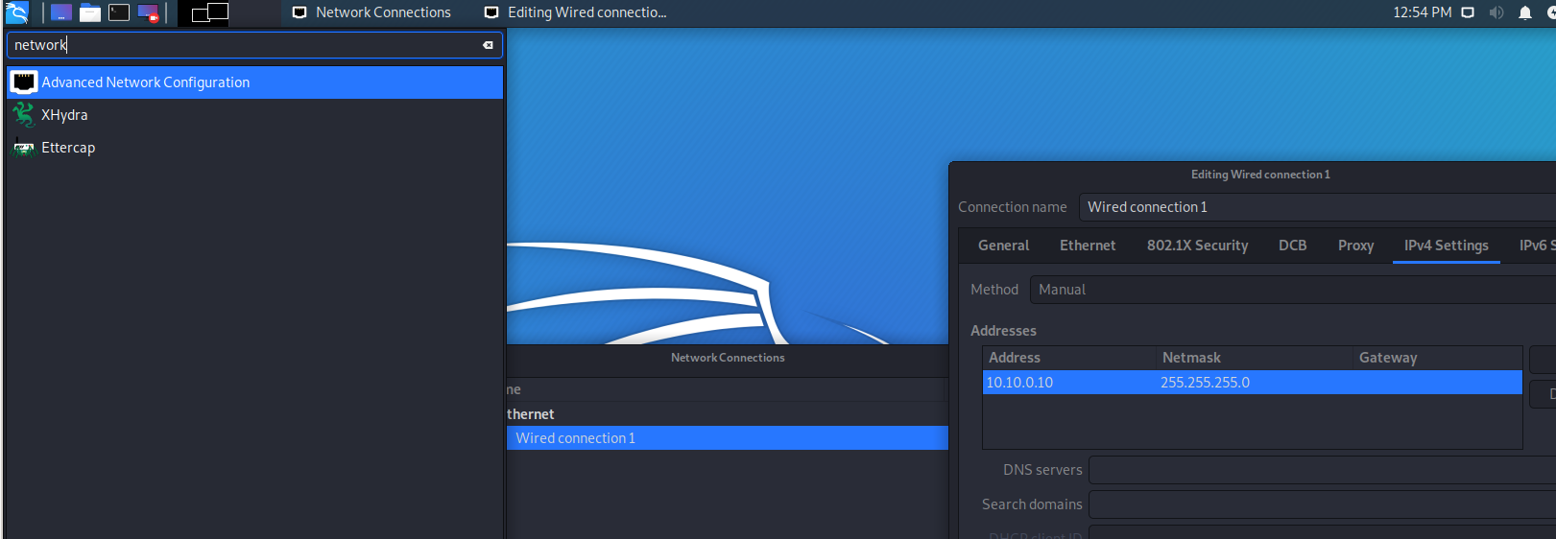
Kali Setup
On Kali
Using GUI, manually set your IP address
Try to ping Metasploitable from Kali to make they are connected
Troubleshooting? Try turning the network adapter off and back on again

Slide 29
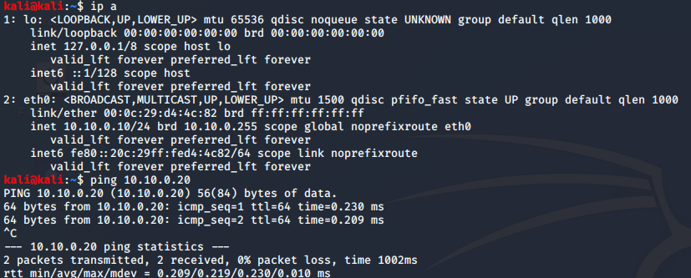
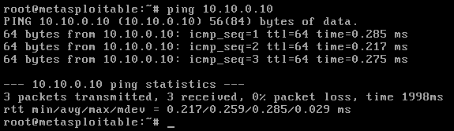
Ping to check
Ping both ways...success!

Slide 30
Networking Issues?

Slide 31
If you try using Bridged
Bridged network doesn't work correctly on some public wifi networks!
Including NYU's wifi
Bridged wifi shares the same physical address of the wlan card for multiple hosts
Bridging does not create a new wireless adapter. It shows up in the VM as an ethernet connection
Some Access Points can detect multiple hosts using the same MAC address and will only service the first host and MAC
This prevents access control attacks
Alice is authenticated to NYU's network using her account credentials
Bob wants network access but does not have credentials
By configuring his MAC address to copy Alice's, Bob might now have access
"Hello, it's still me again, 'Alice'. Can I please have another IP address?"
This attack used to work and still often does in some public places like airports and hotels, places that charge for wifi

Slide 32
Lab 1 Issues
Bridging is needed if we are doing any VM-to-Internet scanning or exploiting in this class
In your academic research or careers with pen testing, we should always get authorization from our ISP if we are going to do some very bandwidth-intensive pen testing
NYU's network may not be satisfactory for some activities
This class will limit our targets to work around bridging limitations
NAT is satisfactory for accessing class website or other basic tasks

Slide 33
No Ping?
Make sure both VMs are attached to the same virtual network interface
E.g. NAT network
Make sure both VMs have IPv4 configured to the same network
E.g. 10.10.0.10/24
Try resetting network interfaces
Disable DHCP if it works then stops
Post questions and screenshots on Slack!

Slide 34
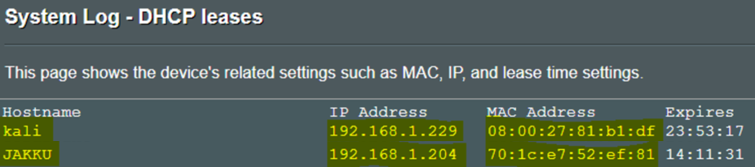
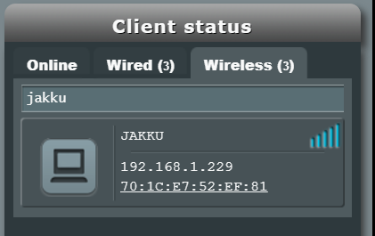
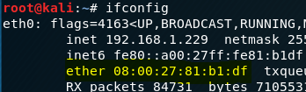

Lab 1 Issues - Shared WLAN MAC address issue
We can see Kali is in bridged mode and has an ethernet interface ending in :df
This shows up in my wireless router's DHCP table
The wireless clients shows a different MAC address though, same as host machine "JAKKU"

Slide 35
Optional -
Deploy Kali, USB

Slide 36
Kali Download
You will not be able to complete the labs or assignments using only a live USB without additional configuration changes – you’re on your own!
OPTIONAL
Difficult to virtualize additional machines which will be provided
Possible to virtualize provided VMs on a separate host on a secure LAN
Download the latest Kali image
https://www.kali.org/downloads/
Using a USB, 4GB or higher
Windows
Download W32 Disk Imager
https://launchpad.net/win32-image-writer
Linux, OS X
Use the dd command
https://docs.kali.org/downloading/kali-linux-live-usb-install

Slide 37
Optional -
Amazon EC2

Slide 38
Kali on the Cloud
You will not be able to complete the labs or assignments using only AWS without additional configuration changes – you’re on your own!
OPTIONAL - You can also create an instance of Kali on AWS
If you are limited by hardware or prefer not to perform pen testing locally
Also a good option if you only have a Mac, at least to get started
https://www.kali.org/news/kali-linux-aws-cloud/
You will need to create an AWS account and provide a credit card for any charges you incur
Unless you qualify for free tier
If this is your first account, you may qualify for the “free tier”
12-months
5GB of storage
750 hours of use per month
Must use t2.micro!
https://aws.amazon.com/s/dm/optimization/server-side-test/free-tier/free_np/

Slide 39
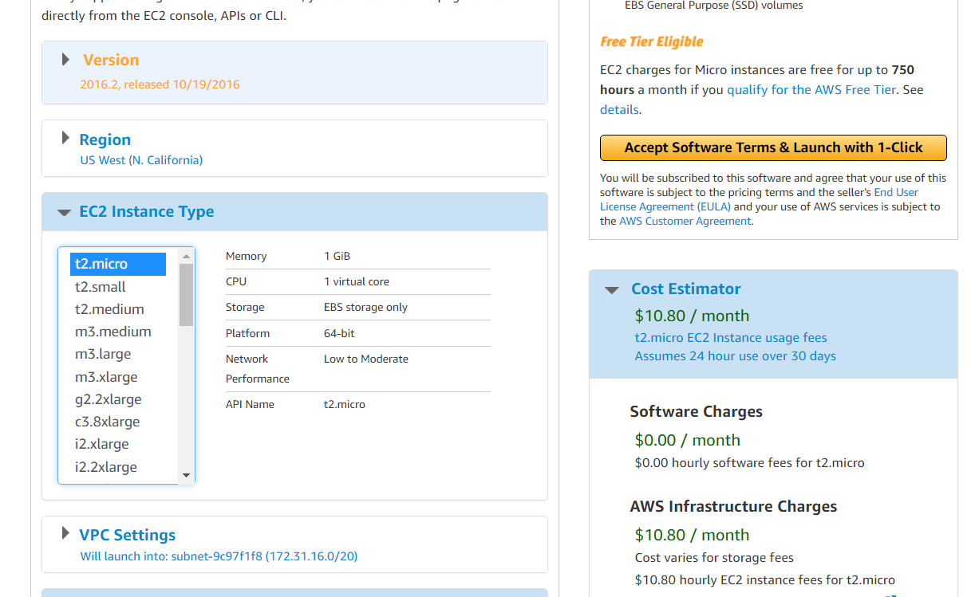
Must select for free tier
AWS Free Tier

Slide 40
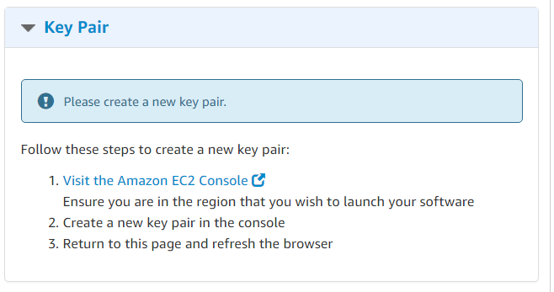
AWS guide
Create a new keypair
You will use this to login over SSH

Slide 41
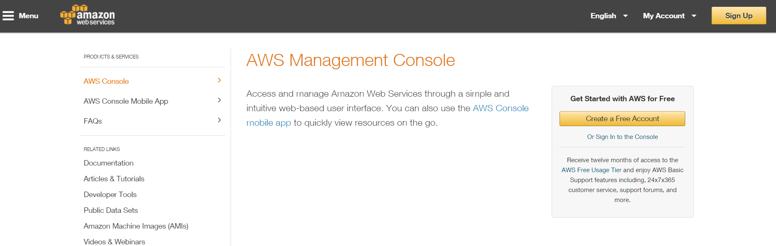
AWS guide
Go to https://aws.amazon.com/console/
Expand, then click AWS Management Console

Slide 42
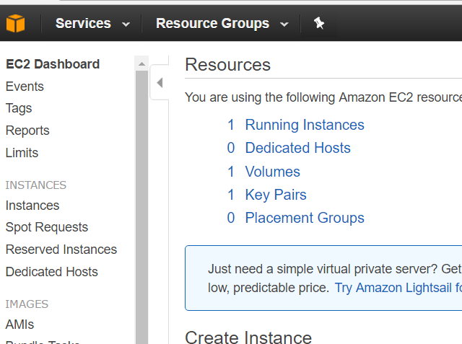
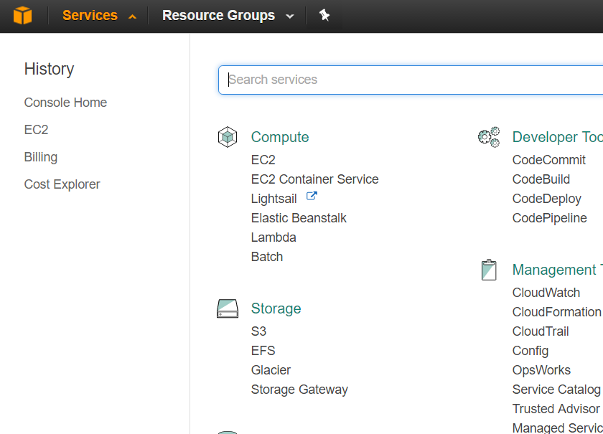
AWS guide
Expand services, EC2
Go to Instances

Slide 43
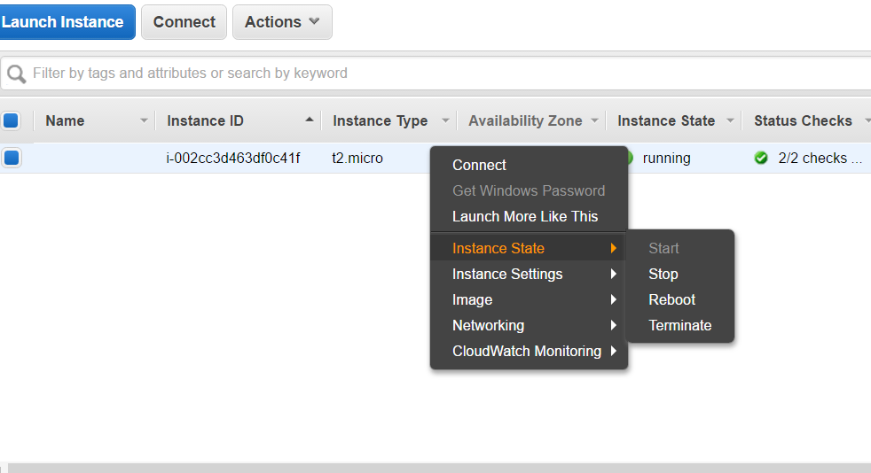
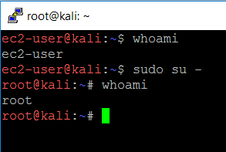
AWS guide
You can right-click and connect, or use an SSH tool like putty
https://docs.aws.amazon.com/AWSEC2/latest/UserGuide/putty.html?icmpid=docs_ec2_console
Log in with your ec2-user username
To get root
? sudo su –
Don’t forget to stop your instance once done

Slide 44
Install Tools
Kali for AWS by default does not come with any tools
Options:
You will need to install each tool you need manually OR
Install a Kali Metapackage!
$ sudo apt-get update
$ sudo apt -y install kali-linux-default
All Metapackages:
https://tools.kali.org/kali-metapackages
More info:
https://www.kali.org/news/major-metapackage-makeover/

